Slide 1
Peri-Intubation Hemodynamic Collapse and Cardiac Arrest
Emergency Department
Tamara Elliott, BSN, RN, TCRN

Slide 2
Peri-Intubation Adverse Events
30% of intubations in ICU and ED associated with hypoxia, hypotension or full arrest
Intubation with pre-existing hemodynamic compromise are at highest risk for collapse/arrest
Failure to recognize high risk conditions contribute to peri-intubation adverse events
Failure to plan and respond contribute to peri-intubation adverse events
Downing et al, 2023
Yang et al, 2022

Slide 3
Risk Factors for Peri-Intubation Cardiac Arrest
Low-normal to hypotensive BP values
Shock index (SI = HR/SBP) >0.9
Cardiogenic pulmonary edema
Elevated lactate
Hypoxia
Advanced age
Downing et al, 2023
Yang et al, 2022

Slide 4
Associated Physiologic Changes
Neuromuscular blockade: Suppression of sympathomimetic and respiratory drive
Rapid transition from negative pressure ventilation to positive pressure
Ventilator positive end expiratory pressure (PEEP)
Oropharyngeal manipulation stimulates sympathetic and parasympathetic NS causing unpredictable hemodynamic response
Yang, et al, 2022

Slide 5
How to Avoid Cardiovascular Collapse and Arrest
Be prepared:
Assess patient for risk factors associated with peri-intubation CV collapse/arrest
Consider rapid fluid resuscitation prior to induction (caution with cardiogenic pulm. edema)
Anticipate need for blood products
Appropriate pre-oxygenation
Anticipate pressors
Downing et al, 2023
Yang et al, 2022

Slide 6
Push-Dose Epi
Used for rapid hemodynamic support
Epinephrine 1:10,000 diluted to 10 mcg/ml
5 – 20 mcg IV push typical dose range
Currently no commercially produced product
Must be prepared by med nurse or pharmacist
Morley et al, 2023

Slide 7
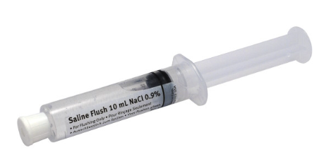
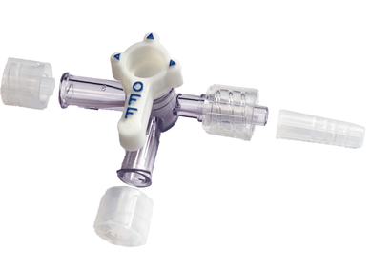
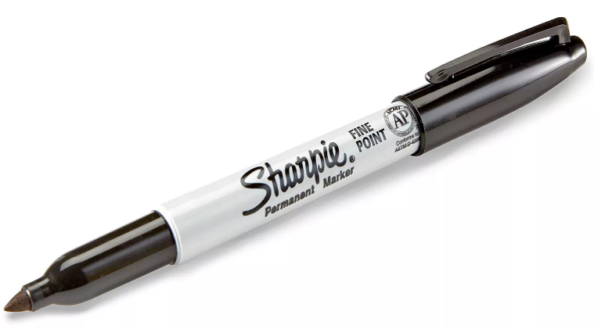
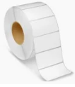
Preparing Push-Dose Epi
What you will need:

Slide 8
Preparing Push-Dose Epi
How you will do it:
Discard 1ml out of 10ml 0.9% NS flush syringe, retaining the remaining 9ml
Draw 1ml of epinephrine 1:10,000 into the NS flush syringe to replace the discarded 1ml flush
Cap and gently mix
Label syringe sticker Epi 100 mcg/10ml = 10 mcg/ml
Place label on syringe
Morley et al, 2023

Slide 9
Words of Caution
Practitioners may not pick up on presence of risk factors once the need to intubate is identified
Consider soft BPs and shock index (SI) >0.9 high risk
Advocate for fluid resuscitation prior to intubation
Assess for presence of rales or coarse lung sounds if CXR has not yet been done

Slide 10
More Words of Caution
Presence of pulmonary edema may reprioritize pressors over aggressive fluid resuscitation
Push-dose epi can buy you time until continuous infusion pressor can be started
Ketamine and propofol have been associated with higher number of cardiovascular collapse/arrest than etomidate as induction agent
Downing et al, 2023

Slide 11
References
References
Downing, J., Yardi, I., Ren, C., Cardona, S., Zahid, M., Tang, K., Bzhilyanskaya, V., Patel, P., Pourmand, A., & Tran, Q. K. (2023). Prevalence of Peri-intubation major adverse events among critically ill patients: A systematic review and meta analysis. The American Journal of Emergency Medicine, 71, 200-216. https://doi.org/10.1016/j.ajem.2023.06.046
Morley, H., Seabury, R., Parsels, K., Miller, C., Darko, W., Schrader, J., & Meola, G. (2023). Preparation/administration of push-dose versus continuous infusion epinephrine and phenylephrine: A simulation. The American Journal of Emergency Medicine, 74, 135-139. https://doi.org/10.1016/j.ajem.2023.10.002
Yang, T., Chen, K., Gao, S., & Lin, C. (2022). Risk factors associated with Peri-intubation cardiac arrest in the emergency department. The American Journal of Emergency Medicine, 58, 229-234. https://doi.org/10.1016/j.ajem.2022.06.013

